Slide 1
Presbyterian Senior Living
2026 Healthcare Benefits

Slide 2



Why Is Open Enrollment Important?
Allows you time to ask
  Does my coverage still meet my needs?
Time to check in on
  Employer-offered benefits
  Financial well-being

Slide 3
Three Medical Plan Options
PPO​ | Preferred provider organization
EPO | Exclusive provider organization
HDHP | High-deductible health plan
All three plans use the same Highmark Blue Cross Blue Shield BlueCard national network.
The difference is per-pay vs. plan-use costs and out-of-network flexibility (PPO).

Slide 4



Medical Plan – Blue Cross Blue Shield BlueCard National Network
2 million+
  care providers nationwide
Network
  coverage in every U.S. ZIP code

Slide 5





Comprehensive Preventive Care​
Preventive​ care visits
Immunizations​
Benefits covered 100% when using network providers​
Routine​ gynecological​ exams
Mammograms​
Preventive​ screenings​
5

Slide 6
Helpful Terms
Your cost for care
Copay | Flat dollar amount you pay for some services
Deductible | Amount you pay out of pocket before the plan begins to pay
Coinsurance | Percentage of an expense you pay after your deductible is met
Annual limits cap your out-of-pocket costs
Medical coinsurance out-of-pocket maximum | PPO only: Most you pay in a year for medical expenses in the form of coinsurance
Total maximum out-of-pocket | Most you pay in a year in the form of network deductibles, copays, and coinsurance
6

Slide 7
Medical Plan – Copays and Deductibles
 | PPO | EPO | HDHP
Copay (Primary care) | $25 | $40 | NA
(Specialist) | $45 | $60 | NA
Deductible (Member-only) | $660-$1,305 | $2,000 | $3,000
(Member + Family) | 2 deductibles | 2 deductibles | $6,000*
*Members with covered spouses and/or children are responsible for the entire family deductible amount.
7

Slide 8
Medical Plan – Out-of-Pocket Maximums
 | PPO | EPO | HDHP
Medical coinsurance out-of-pocket maximum* | $2,200-$4,340 | NA | NA
Prescription out-of-pocket maximum* | $3,000** | NA | NA
Total maximum out-of-pocket | $5,000/member $10,000/family | $5,000/member $10,000/family | $5,000/member $10,000/family
*Member and family combined.
**Excludes non-formulary brand names and certain nonessential specialty pharmacy drugs.
8

Slide 9






Health Savings Account (HSA)
Contribute up to annual IRS limit in pretax dollars, no rollover limit
Eligible expenses
Deductible, copays, coinsurance
  Prescription drugs, dental, and vision
  And more ...
Funds are invested and earnings grow tax-free
You own it — it goes with you

Slide 10



Prescription Drug Benefits
Based on a formulary
(preferred drug list)
Helpful terms to understand:
  Preventive drugs
  Formulary/non-formulary
  Generic/brand
  Retail/mail
10

Slide 11


Prescription Drug Benefits – Preventive Drug List
 | PPO | EPO | HDHP
Generic retail* | $5 | $6 | $6
Formulary brand retail* | $20 | $30 | $30
What types of medications are on the preventive drug list?
  Antidepressants
  Medications for high blood pressure, high cholesterol, diabetes, and more
*30-day supply; not subject to HDHP deductible.
Save on out-of-pocket costs for covered drugs by using Express Scripts home delivery service.
11

Slide 12
Prescription Drug Benefits – 30-Day Retail​
​ | PPO​ | EPO​ | HDHP​
Generic​ | $10​ | $12​ | 100% until deductible ​ is met; then 30% (up to ​$150 max)​
Formulary brand​ | 30% of cost;​ $20 min-​ $100 max​ | 35% of cost;​ $35 min-​ $150 max​
Non-formulary ​ brand​ | 50% of cost;​ $50 min-​ $150 max​ | Not covered​ | Not covered​
$
$$
$$$
You could save time and money by using home delivery for​
a 90-day supply of your medication.​
12

Slide 13
Potential Out-of-Pocket Costs: Examples

Slide 14
Potential Out-of-Pocket Costs: Mia’s Simple Fracture
Total example cost $2,800
Network emergency room visit and follow-up care, including services like
emergency room care (with medical supplies), diagnostic test (X-ray), durable medical equipment (crutches), and rehabilitation services (physical therapy)
Cost-sharing | PPO | EPO | HDHP
Deductibles | $875 | $2,000 | $2,800
Copays | $0 | $320 | $0
Coinsurance | $385 | $160 | $0
Mia’s total out-of-pocket cost for care | $1,260 | $2,480 | $2,800
This is not a cost estimator. Treatments shown are just examples of how this plan might cover medical care. Your actual costs will be different depending on the actual care you receive, the prices your providers charge, and many other factors. Example is based on Member-only coverage.

Slide 15
Potential Out-of-Pocket Costs: Managing Joe’s Type 2 Diabetes
Total example cost $5,600
One year of routine network care of a well-controlled condition, including services like
primary care doctor’s office visits (including disease education), diagnostic tests (blood work), prescription drugs, durable medical equipment (glucose meter)
Cost-sharing | PPO | EPO | HDHP
Deductibles | $875 | $2,000 | $3,000
Copays | $405 | $420 | $0
Coinsurance | $945 | $720 | $520
Joe’s total out-of-pocket cost for care | $2,225 | $3,140 | $3,520
This is not a cost estimator. Treatments shown are just examples of how this plan might cover medical care. Your actual costs will be different depending on the actual care you receive, the prices your providers charge, and many other factors. Example is based on Member-only coverage.

Slide 16
Potential Out-of-Pocket Costs: Peg Is Having a Baby
Total example cost $12,700
Nine months of network prenatal care, including services like
specialist visits (prenatal and anesthesia), diagnostic tests (ultrasounds and bloodwork), professional and facility services for childbirth/delivery
Cost-sharing | PPO | EPO | HDHP
Deductibles | $875 | $2,000 | $6,000
Copays | $0 | $0 | $0
Coinsurance | $2,365 | $2,140 | $1,340
Peg’s total out-of-pocket cost for care | $3,240 | $4,140 | $7,340
This is not a cost estimator. Treatments shown are just examples of how this plan might cover medical care. Your actual costs will be different depending on the actual care you receive, the prices your providers charge, and many other factors. Example is based on Member + Family coverage.

Slide 17




Which Medical Option Is Right for Me? ​
How often do you use healthcare services​?
Are drugs you take on the plan’s formulary?
What is the per-pay cost for coverage?​

Slide 18
Special Features

Slide 19



Connect with Quantum Health
Offers personalized support when you have questions about your medical benefits
Verify covered services and benefits
Find network providers
Help with managing a health condition
Connect you with community-based resources
Answer claims and billing questions
Replace lost ID cards
Quantum Health’s Care Coordinators get to know
you and your health and wellness needs to make sure
you receive high-quality, safe, and cost-effective care.
19
27

Slide 20

Locating Network Providers
Log in to myqhealthpcusa.org and
use the Care Finder tool to find network doctors near you.
  Determine which doctors are in network.
  Find a doctor with expertise that meets your
  healthcare needs.
  Confirm that the doctor is accepting new patients.
  If not yet enrolled, call Quantum Health at 855-497-1237.
Take these steps

Slide 21


Call to Health
Call to Health, the Board’s online well-being program, encourages participants to focus daily on four aspects of wholeness: spiritual,
health, financial, and vocational.
Eligibility and participation:
  Medical Plan members and enrolled spouses
  Register through Call to Health website or app
  Complete activities to answer
  the call
Program features:
  High-level of personalization
  Employees can qualify for reduced deductibles
  Spouses can earn a gift card
21

Slide 22

Call to Health
​ | Deductible ​without​ Call to Health​ | Deductible ​with​ Call to Health​
PPO​ | $660-$1,305​ | $440-$870​
EPO​ | $2,000​ | $1,500​
HDHP​ | $3,000/​member ​ $6,000/​family​* | $2,250/​member ​ $4,500/​family​*
Answer the Call to Health each year to qualify for reduced deductibles for the following plan year.
*Members with covered spouses and/or children are responsible for the entire family deductible amount.

Slide 23
How Call to Health Works
Answering the Call to Health is easy!
Step 1
Take the confidential Well-Being Assessment
Step 2
Get a preventive exam and record the date of your exam
Complete optional activities optional activities to earn points
Step 3
Complete steps 1, 2, and 3 to save as much as one-third on your medical deductible next year
Qualify for reduced medical deductibles
Covered spouses who answer the call receive a $100 Tango e-gift card.
23

Slide 24





Mental Well-Being Benefits
Support for your mental well-being, when and how you need it
Mental health care navigators
Unlimited coaching
Work/life support
with certified coaches
connect you to providers and resources
to manage major life events and more
ICON
Private therapy
On-demand exercises
and medication management
for immediate relief and long-term skills

Slide 25




Telemedicine through Teladoc Health
24/7 access to
U.S. board-certified doctors
Phone, video, or mobile app
Lowest-cost option for many
acute conditions
Prescriptions sent directly
to the pharmacy
8 minutes
Average doctor
response time
92%
Member
satisfaction
25

Slide 26
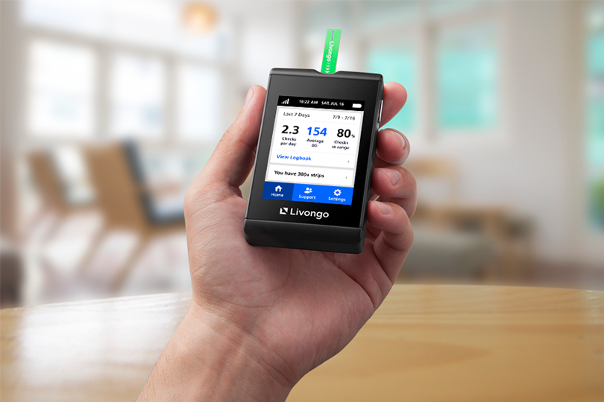


Diabetes Management Program
Support for those living
with diabetes
Access to 24/7 diabetes coaching by phone, email, text, or mobile app
Blood glucose meter, unlimited test strips, and lancets
No cost to covered member or eligible family members
26

Slide 27



Centers of Excellence – Blue Distinction
Designated facilities proven to deliver superior results
100% coverage after deductible for facility charges for select surgeries at a Center of Excellence
  Bariatric surgery
  Knee and hip re﻿placements
  Spinal surgery
  Transp﻿lants
Travel benefit of up to $10,000 if more than 100 miles away
27

Slide 28
Assistance Program

Slide 29
Assistance Program of the Board of Pensions​
The Assistance Program embodies our connectional Church at its best. Active and retired members of the Benefits Plan of the PC(USA) who demonstrate financial need are eligible to apply.
Supported through donations; fully 100% of each gift goes to those in need.
In 2024, a total of $9.6 million in funds were distributed.
Amounts awarded and eligibility vary.

Slide 30



Assistance Program
Adoption Assistance
$6,500 per child
Dependent child under age 21
Emergency Assistance
Up to $5,000
Initiated by an individual or employer
All Members
Transition-to-College Assistance
$2,000
For post-high school education or training;
additional $1,000 for a PC(USA) college or university

Slide 31


Assistance Program
Emergency or unexpected needs
Up to $5,000
Need due to sudden expense or natural disaster
Initiated by an individual or employer
Emergency
Assistance
Eligibility
Employed by a PC(USA)-affiliated organization
Enrolled for at least one benefit through the Board of Pensions
31

Slide 32
Assistance Program
Education debt relief
$25,000 maximum, no annual limit
Debt from a national student loan lender
Employee
Vocation Program
Eligibility
Employed at least 20 hours/week
Medical Plan enrollment for at least six months
Salary that does not exceed $80,000 per year
32

Slide 33




800-PRESPLAN
(800-773-7752) (TTY: 711)
M-F 8:30 a.m. to 6 p.m. ET
memberservices@pensions.org
memberservices@pensions.org
This is not a full description of benefits and limitations of the plan. If there is any difference between the information presented here and the provisions of the Benefits Plan of the Presbyterian Church (U.S.A.), the plan terms will govern. Visit pensions.org or call the Board at 800-PRESPLAN (800-773-7752) (TTY: 711) for a copy of the plan document.
pensions.org/members
www.psl.org/benefits
33

